Slide 1


DETERMINING THE FACTORS CONTRIBUTING TO THE CAUSE OF DEATH DUE TO DRUG OVERDOSE IN THE MOST AFFECTED REGIONS OF USA
Spring 2022 INFO-501 GROUP-11
Team Members
Gundarapu Sai Varshith Reddy
Sai Sreya Tummala
Ruchika Reddy Chimmula
Manasi Somasundaram
Vaishali Lavangu
Sadhveer Punugoti

Slide 2
Introduction

Slide 3
Drug overdoses are a major concern in health care, public health, and society at large.
Overdoses can occur due to medical errors or active consumption of narcotic drugs like opioids.
In 2019, 70,630 drug overdose deaths occurred in the United States according to CDC data [1]. Children are at higher risk of accidental overdosage of drugs.
In the USA prescription opioids have long been the most common drug involved in overdose deaths, but heroin and synthetic opioids most notably illicit fentanyl [2] are increasingly being linked to overdose deaths.
Identifying opportunities to intervene prior to an overdose death and putting in place evidence-based prevention policies, programs, and practices could help save lives.
Preventing the misuse of prescription opioids and stimulants, as well as illegal drug usage, should be a part of these efforts.

Slide 4
Research questions and predictions

Slide 5
Research questions:
To study the cause of death in terms of drug availability and mode of drug intake.
Role of narcotic drugs contributing to death severity.
Prediction:
Possibly predict the description of injury based on various factors like age, gender, residence city, residence county, location, etc.
Implement clustering to allocate drugs based on their pharmacological class and assign appropriate clustered drugs to the test data inputs.

Slide 6
HYPOTHESIS

Slide 7
Null Hypothesis:
Mode of drug intake, drug availability, and the role of narcotics, do not affect the cause of death and death severity and the description of the injury and pharmacological class of drug responsible for mortality cannot be predicted.
Alternative Hypothesis:
Mode of drug intake, drug availability, the role of narcotics, affect the cause of death and death severity and the description of the injury and pharmacological class of drug responsible for mortality can be predicted.

Slide 8
DATA COLLECTION

Slide 9
Data Source:
https://www.kaggle.com/demonicknyght/drug-overdose-deaths-in-the-us
SQL
PYTHON

Slide 10
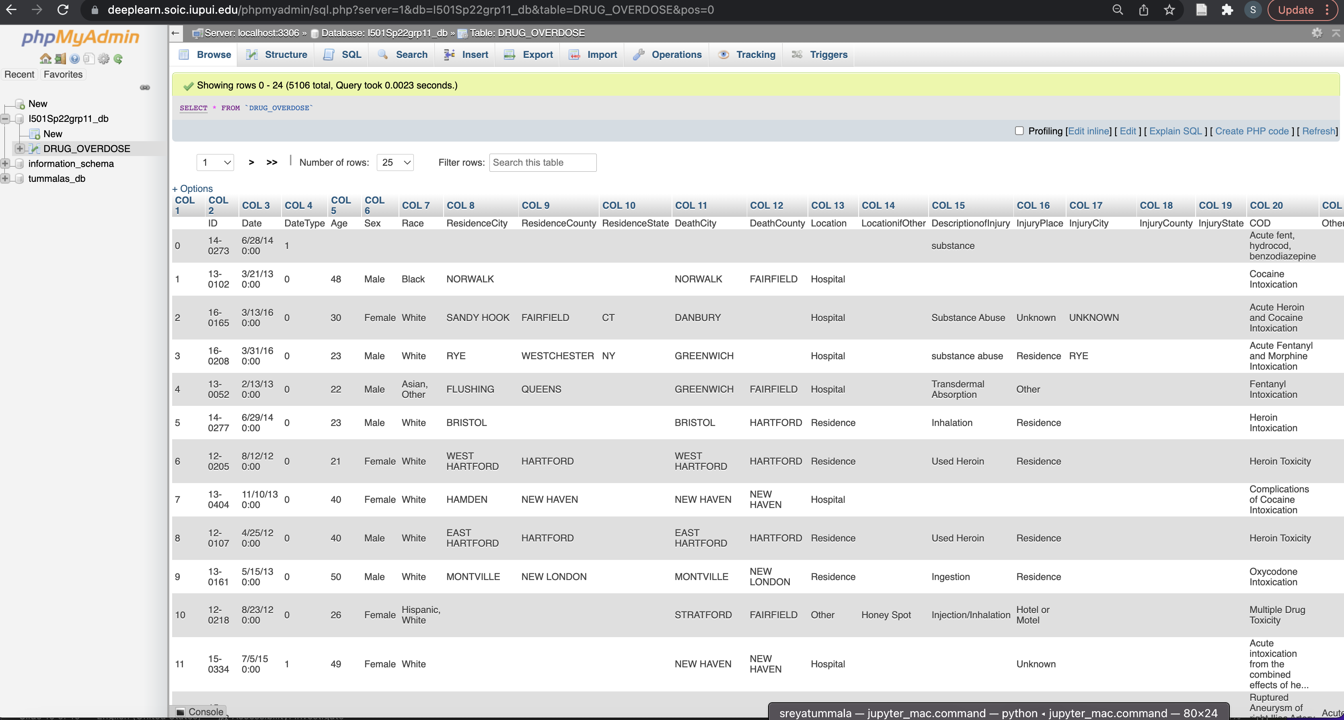

Slide 11
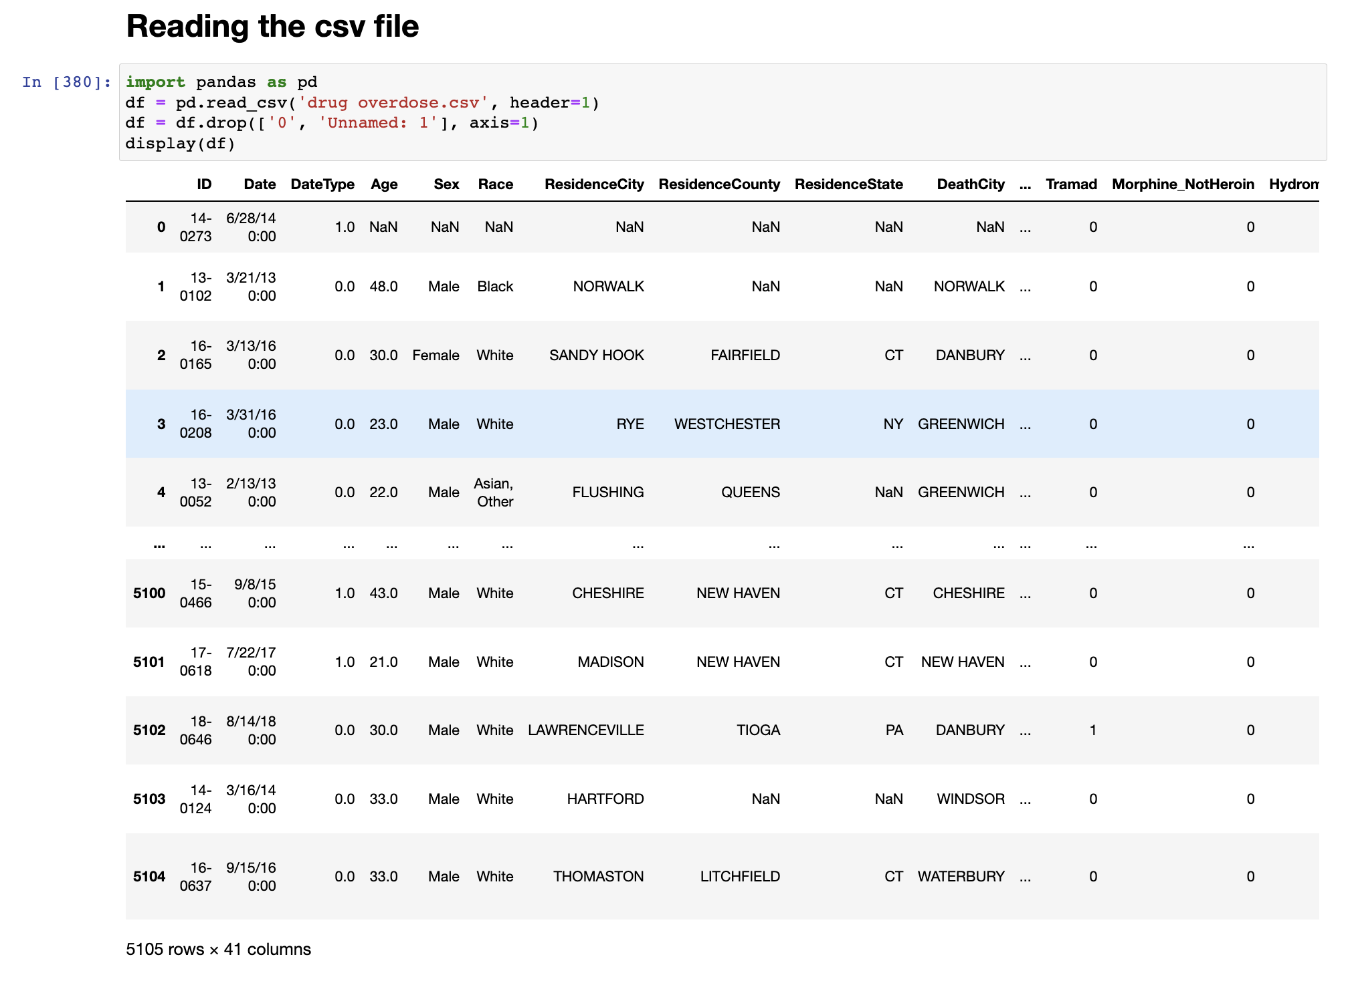
Reading DRUG_OVERDOSE CSV File in Python

Slide 12
DATA CLEANING

Slide 13
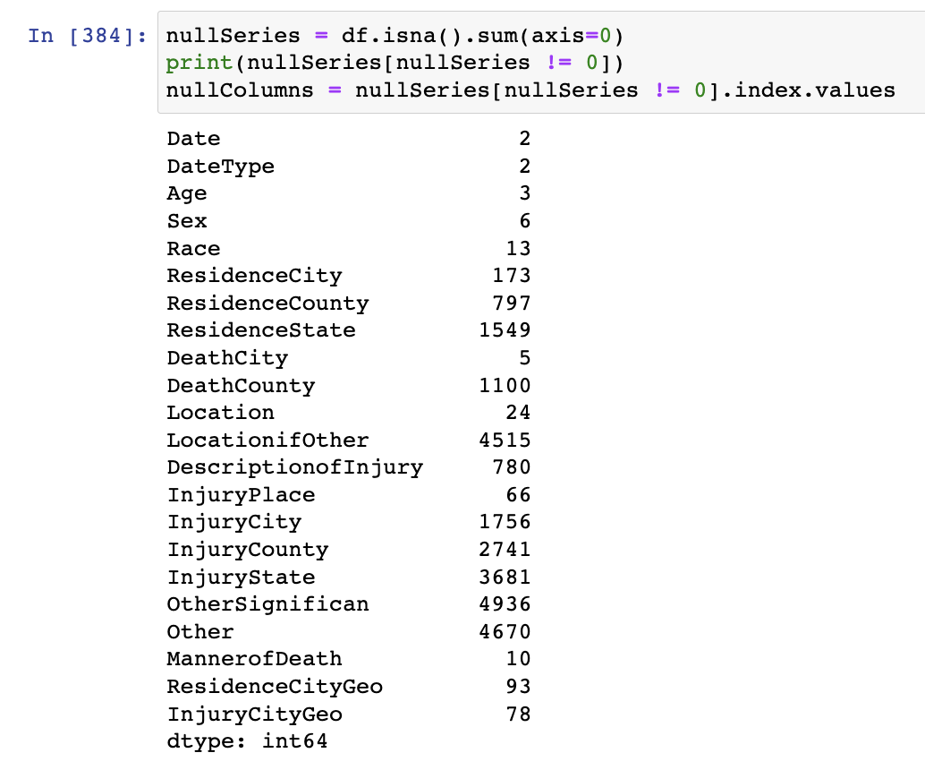
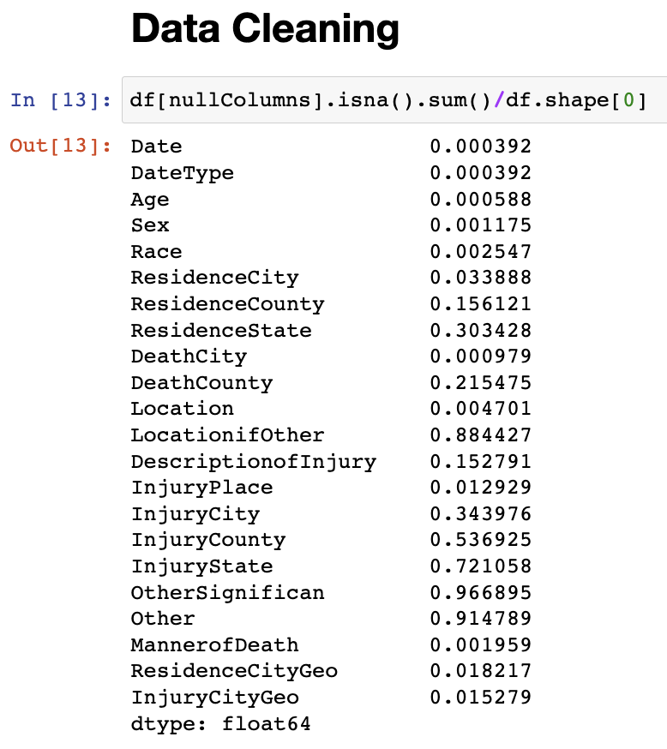
Identified columns that have null values
Columns that have more than 50% of null values are identified

Slide 14
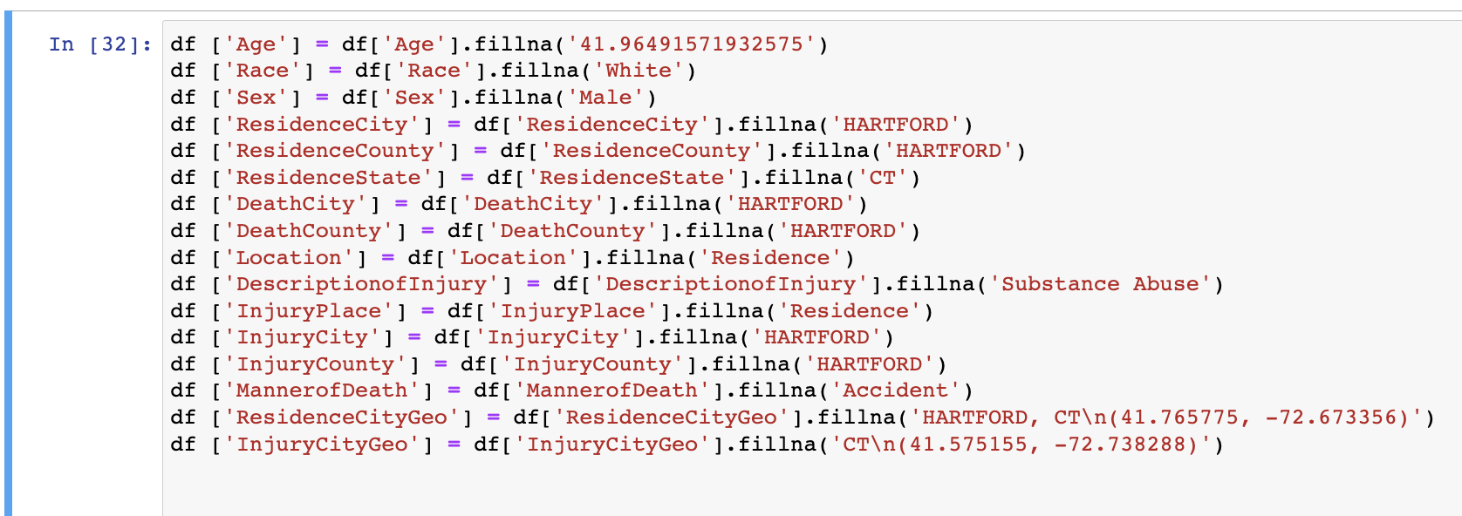
Dropping the columns having more than 50% of null values
Replacing the columns containing null values with mode except for Age. Age is replaced with mean.

Slide 15
DATA VISUALIZATION

Slide 16
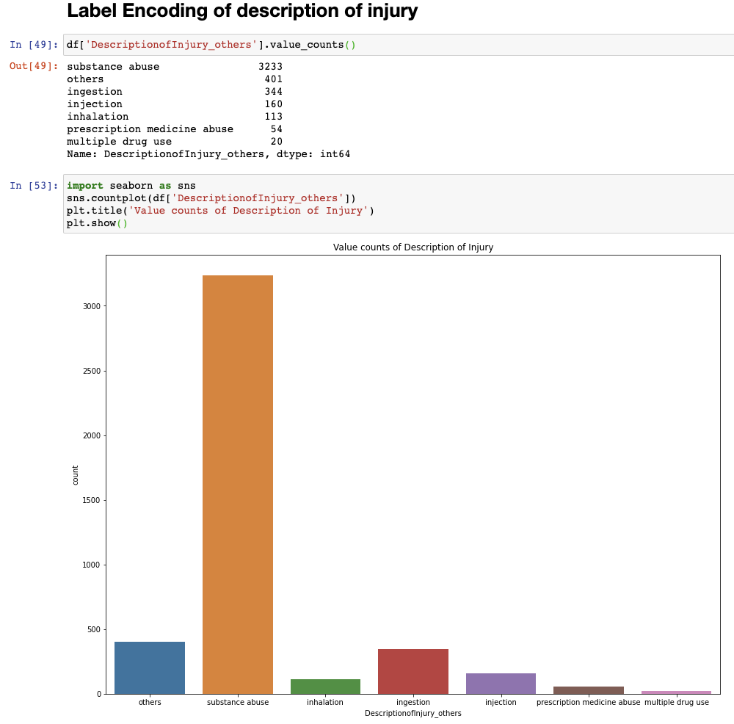
Similarly, we have done the label encoding for all the comparing columns and visualized them.

Slide 17
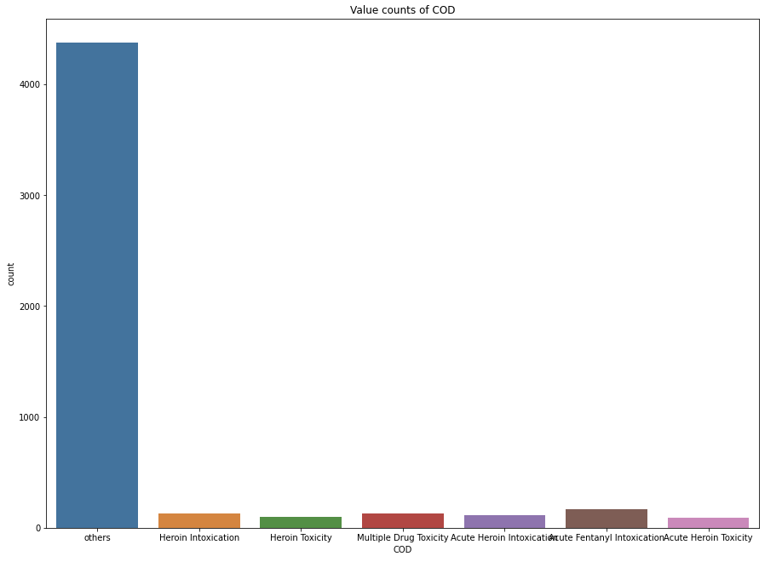
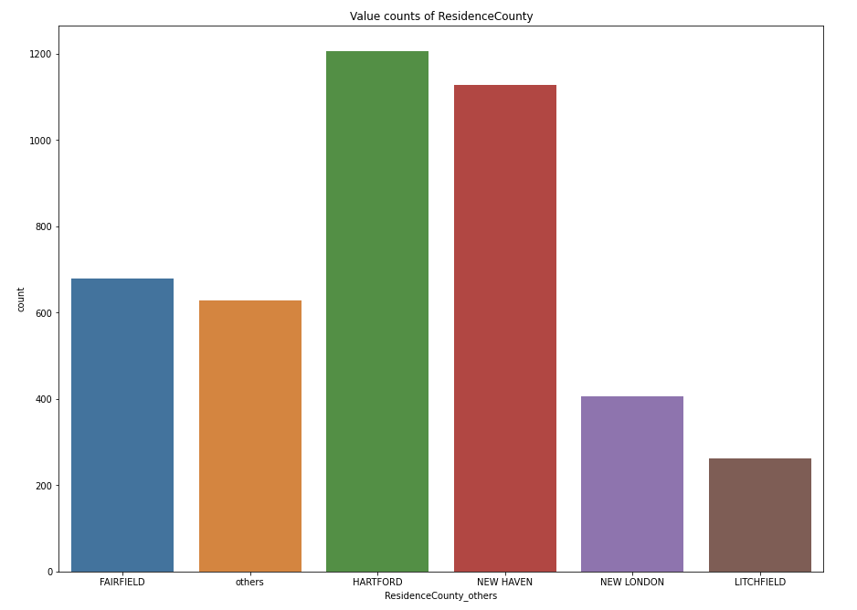
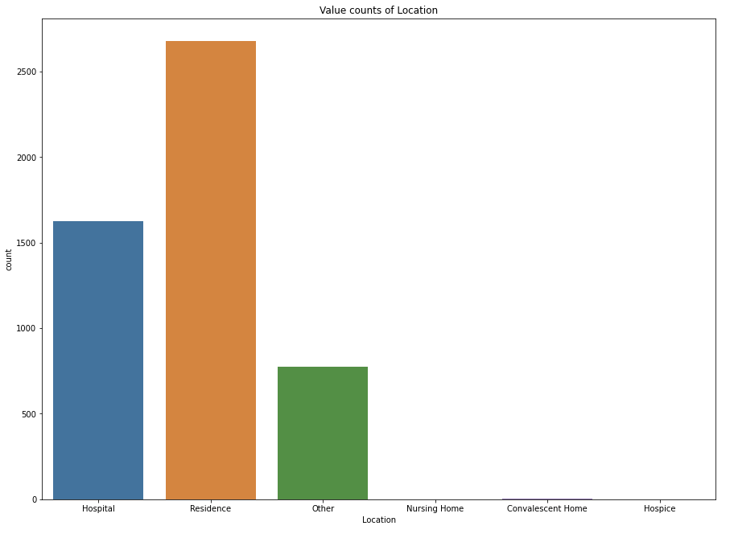
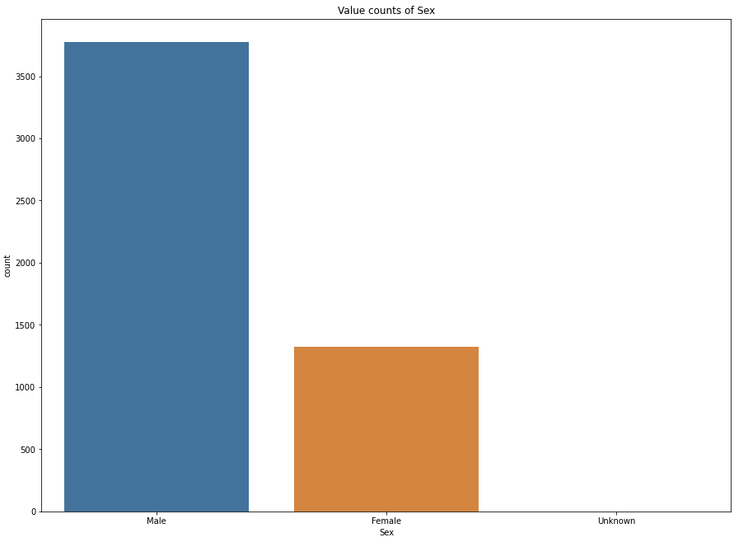
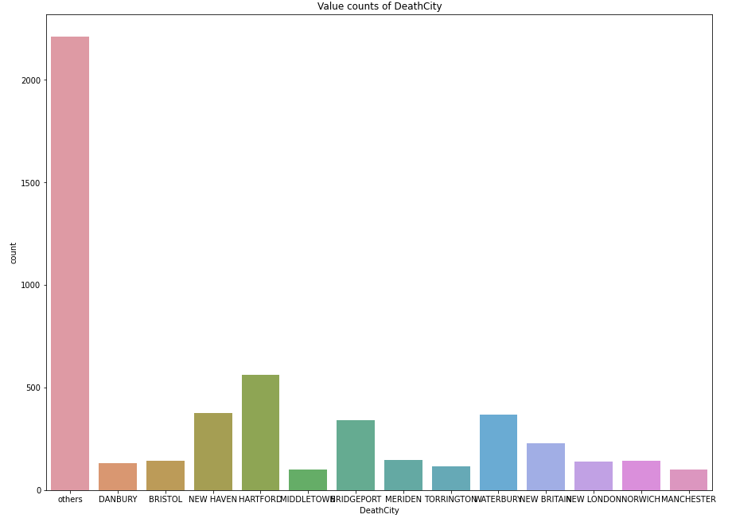
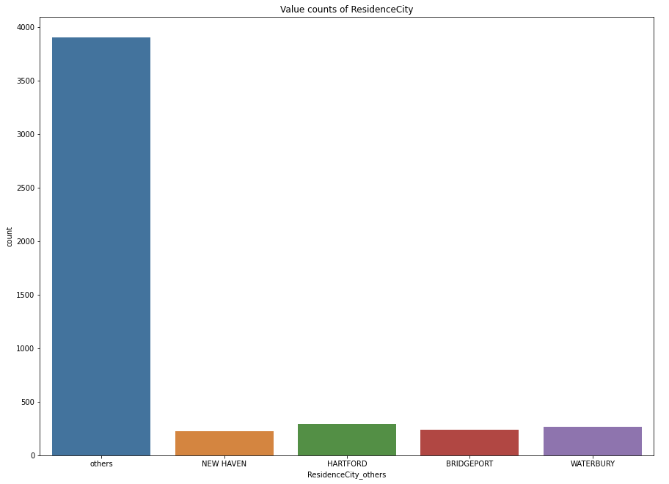

Slide 18
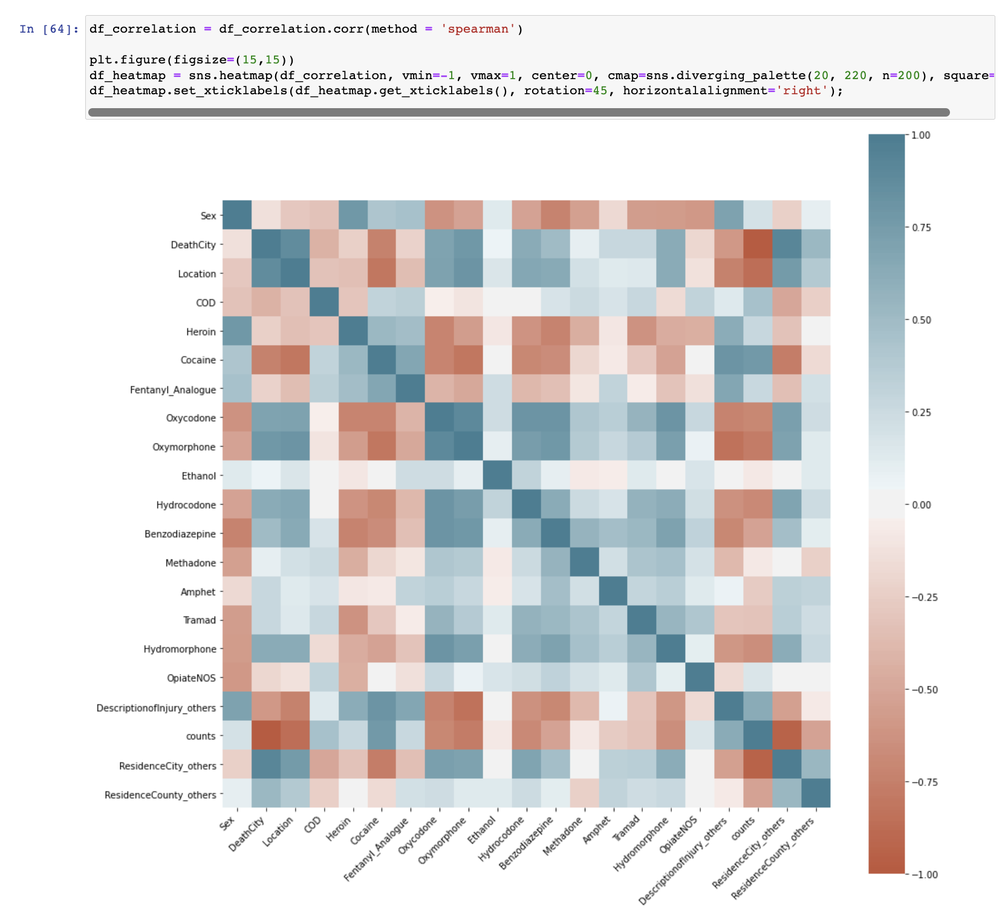
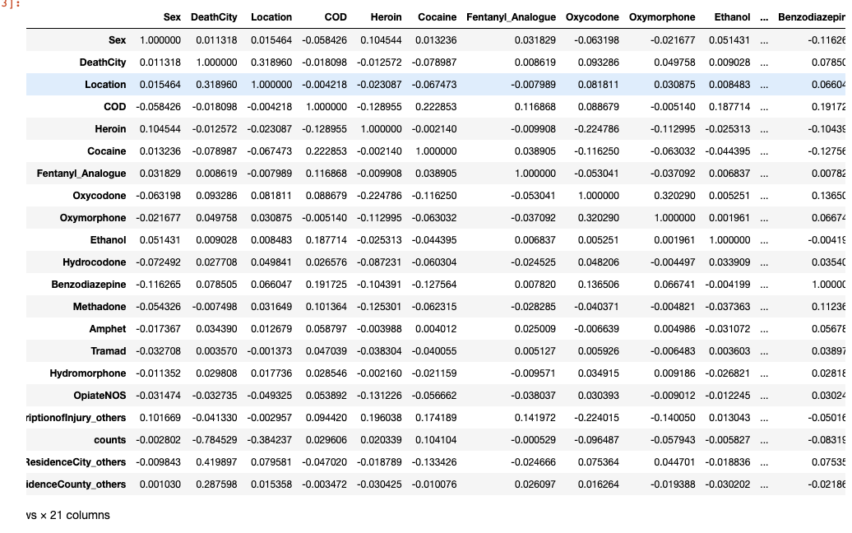
CORRELATION HEATMAP

Slide 19
hYPOTHESIS TESTING-STATISTICAL TESTS

Slide 20
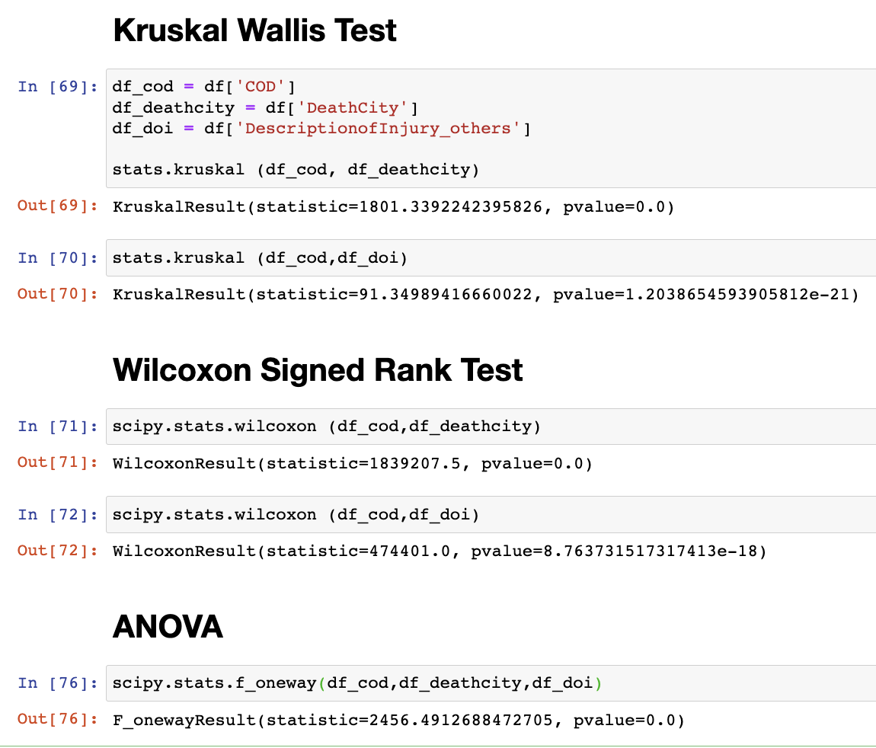
In all the three statistical tests performed,
the ‘p’-value is less than 0.05. So, we
reject the null hypothesis.

Slide 21
PREDICTIVE MODELLING- CLASSIFICATION

Slide 22
GOAL: To predict the description of injury based on various factors like age, gender, residence city, residence county, location, and pharmacological class.
Dependent variable:
DescriptionofInjury_others
Independent variables:
Age, Sex, ResidenceCity_others, ResidenceCounty_others, Location, COD, DeathCity, PharmacologicalClass
Models used to perform prediction:
Logistic Regression
Random Forest Classifier
Support Vector Machines
Decision Trees

Slide 23
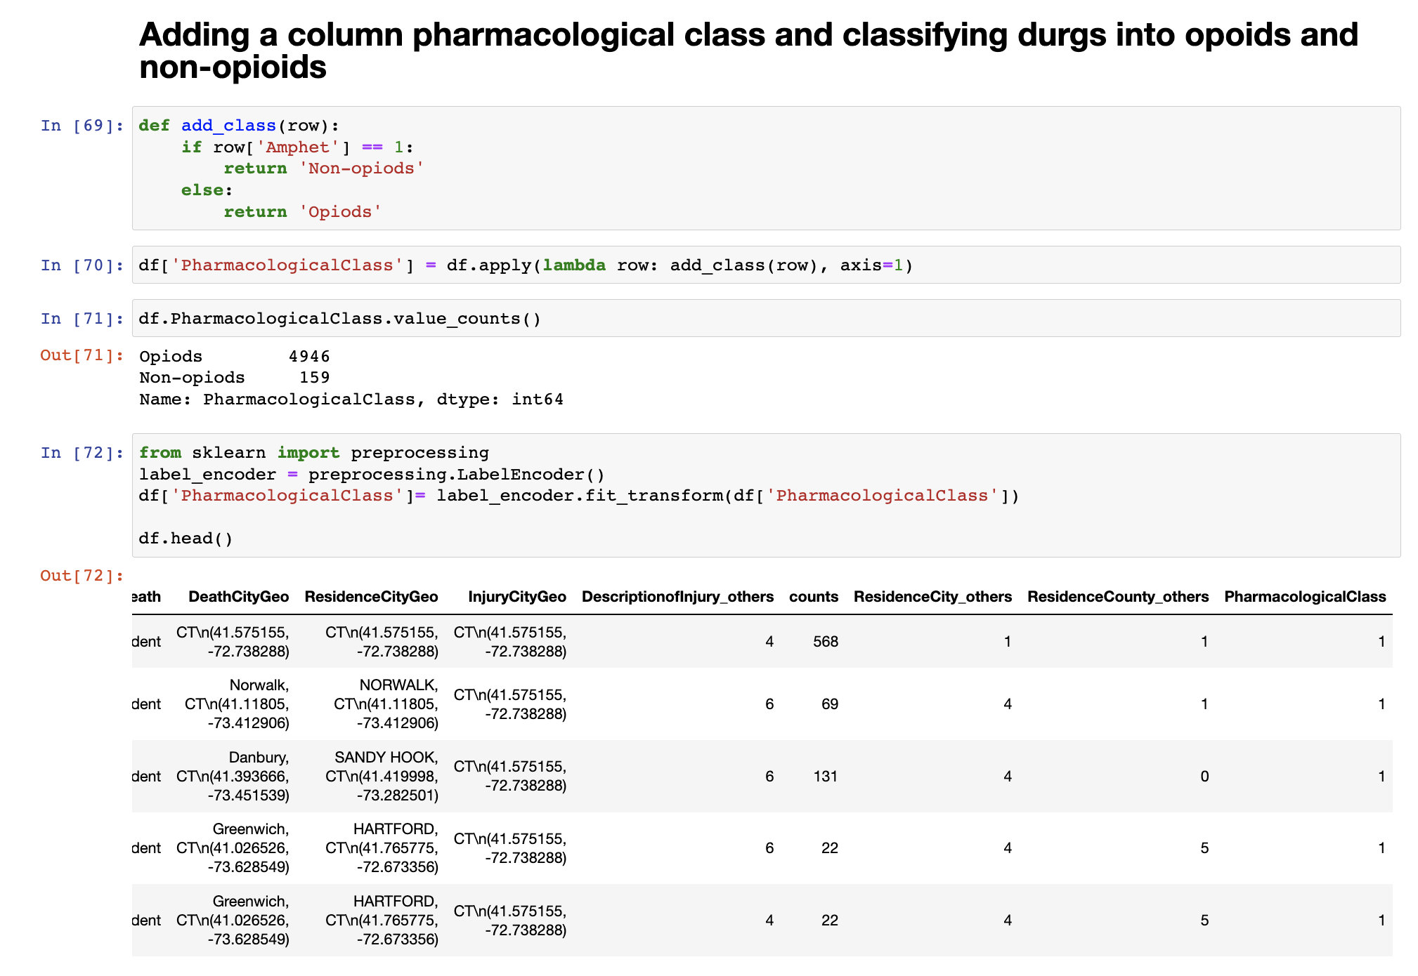

Slide 24
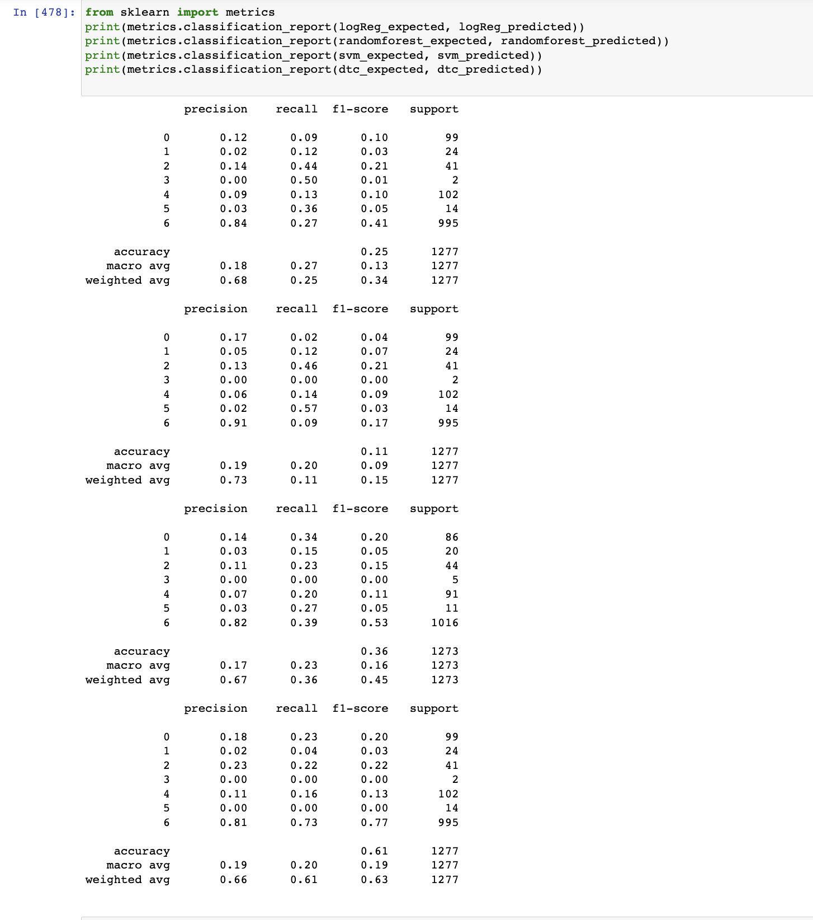
CLASSIFICATION REPORT OF ALL THE MODELS

Slide 25
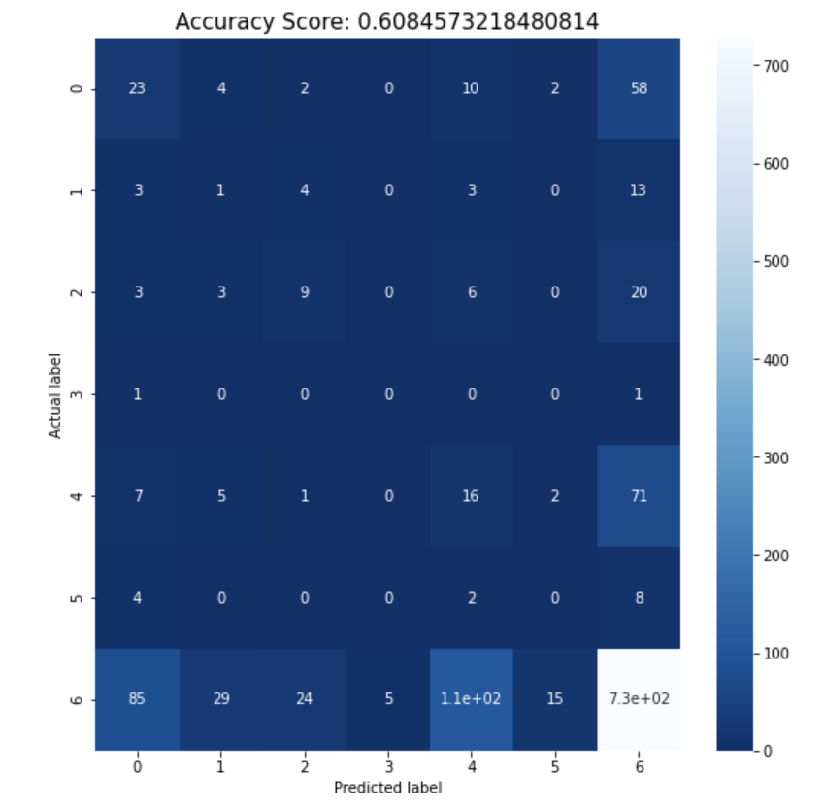
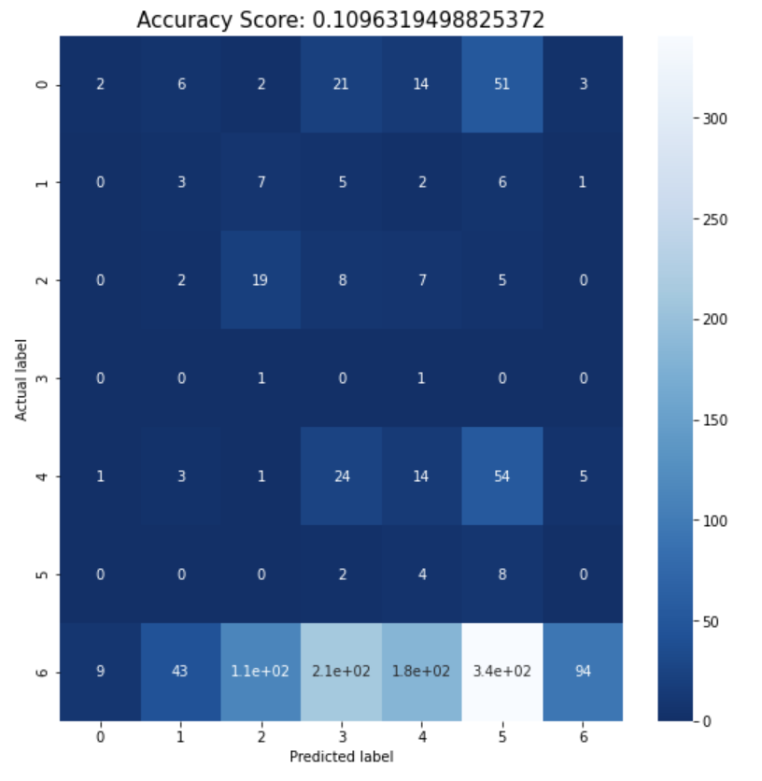
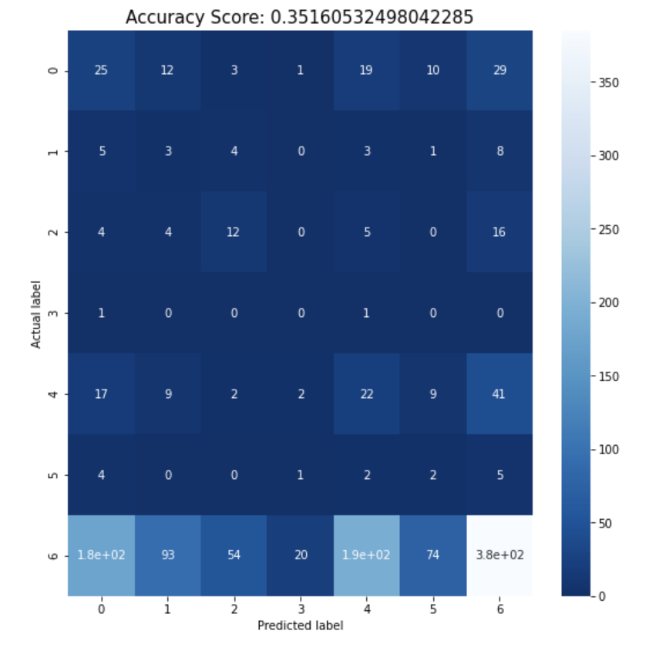
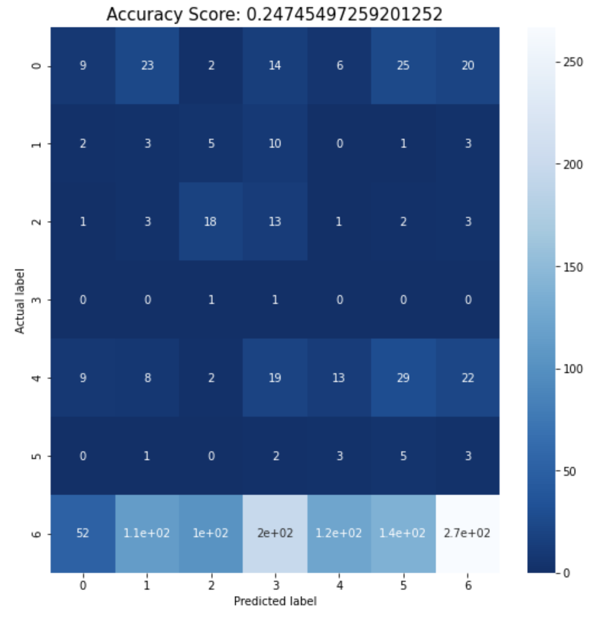
CONFUSION MATRIX PLOT OF ALL MODELS
Decision Trees
Random Forest Classifier
Decision Tress - 0.608
Support Vector Machine - 0.351
Logistic Regression - 0.247
Random Forest Classifier - 0.109
Support Vector Machine
Logistic Regression

Slide 26
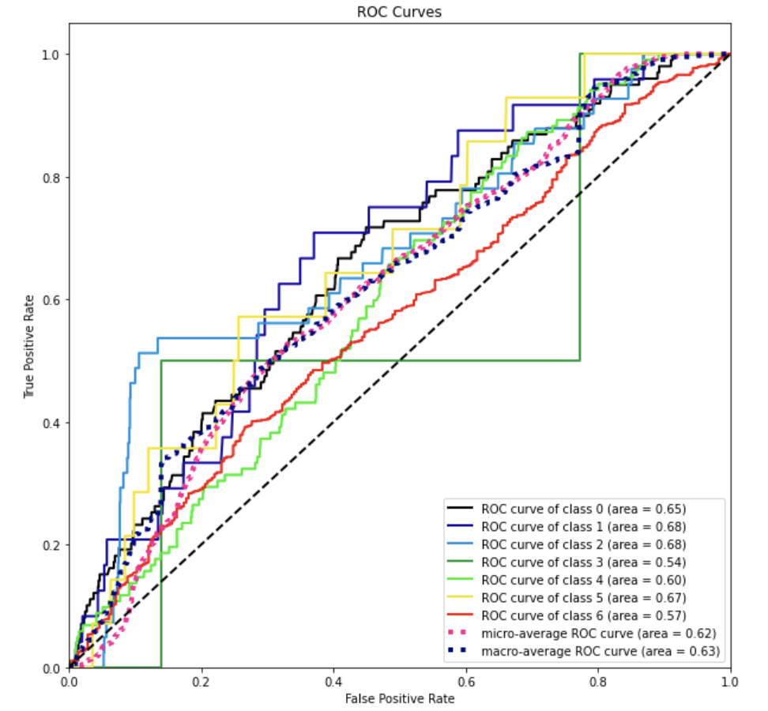
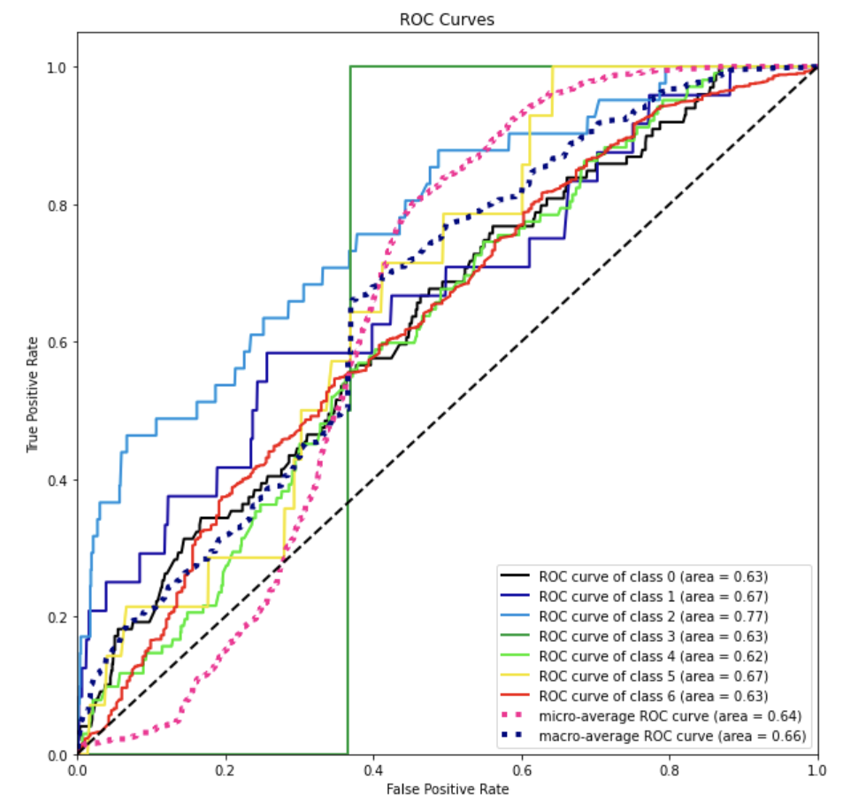
PLOTTING ROC CURVES FOR ALL MODELS:
Logistic Regression
Random Forest Classifier

Slide 27
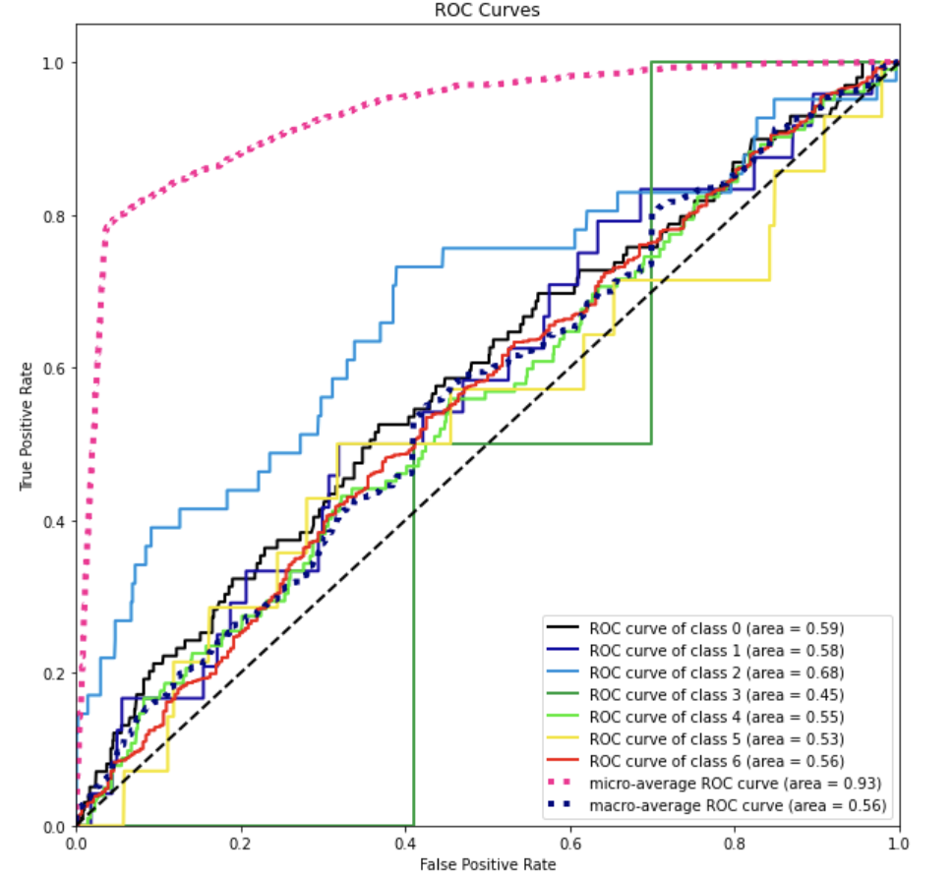
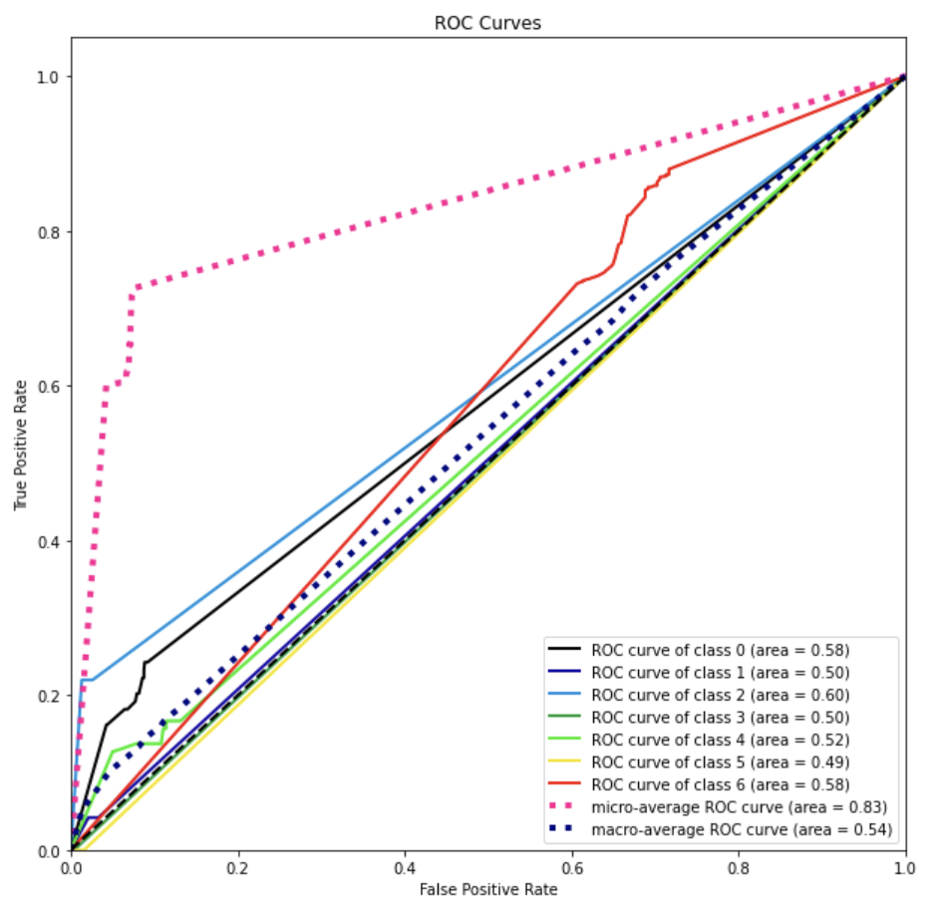
Support Vector Machine
Decision Trees

Slide 28
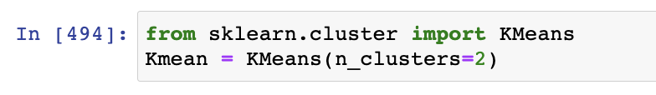
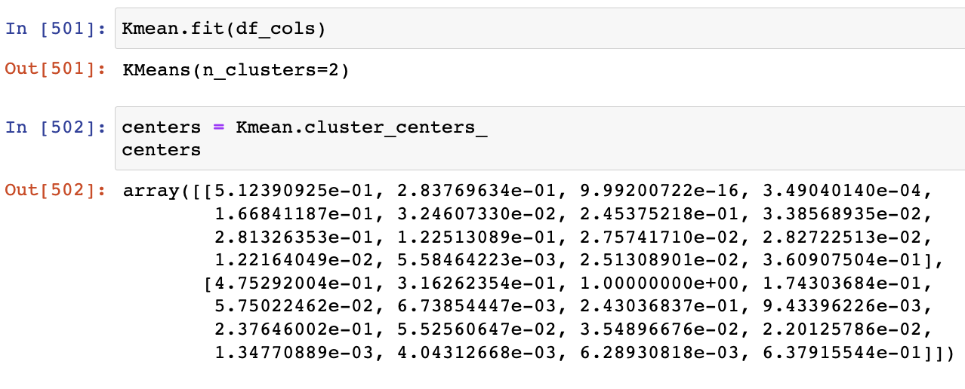
K-MEANS CLUSTERING

Slide 29
CONCLUSION

Slide 30
After exploring the data and performing adequate analysis and modeling, it is seen that the Cause of death is negatively correlated to Drug availability and positively correlated to the Mode of drug intake.
Out of all the models proposed, Decision Trees is able to perform prediction with 60% accuracy.
It is observed that, with the provided data, the probability of predicting the description of injury based on proposed variables is relatively low.
Implementing visualization for clustering is not possible with our data.

Slide 31
REFERENCES:
https://www.cdc.gov/drugoverdose/deaths/index.html
Wilson, N., Kariisa, M., Seth, P., Smith, H., & Davis, N. L. (2020). Drug and Opioid-Involved Overdose Deaths — United States, 2017–2018. MMWR. Morbidity and Mortality Weekly Report, 69(11), 290–297. https://doi.org/10.15585/mmwr.mm6911a4

Slide 32
APPENDIX

Slide 33
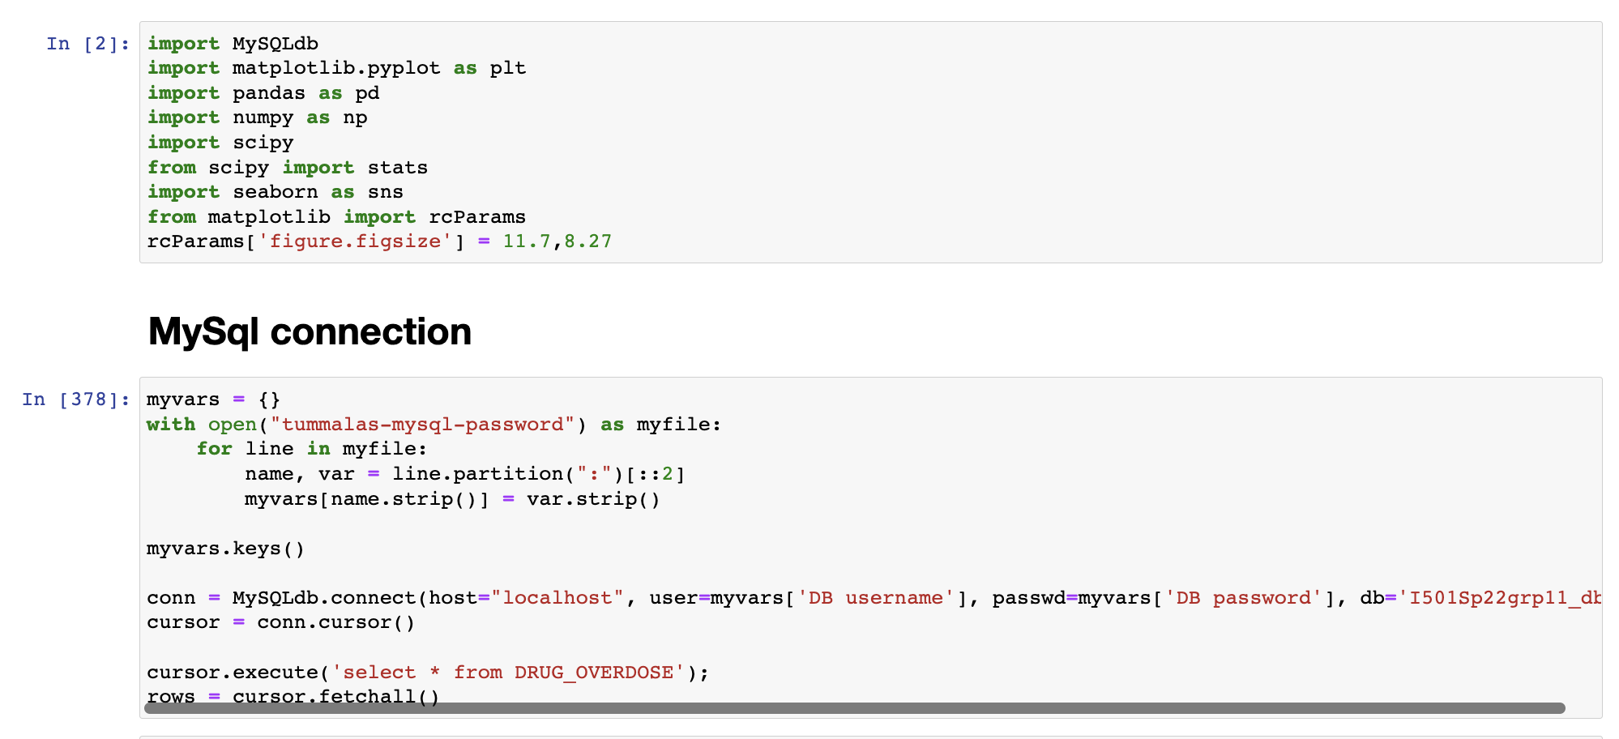

Slide 34
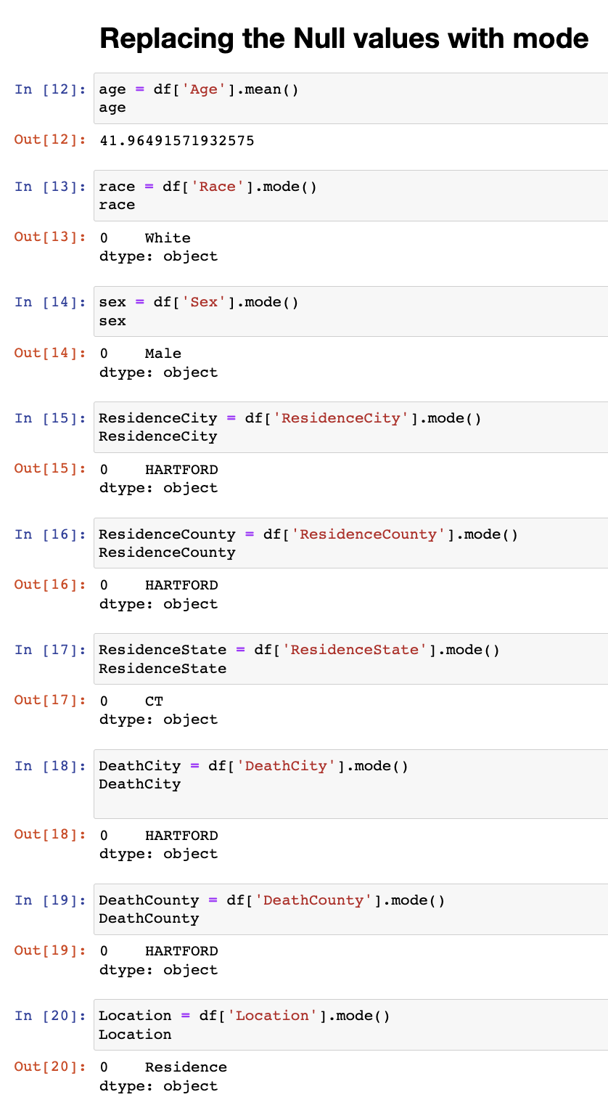
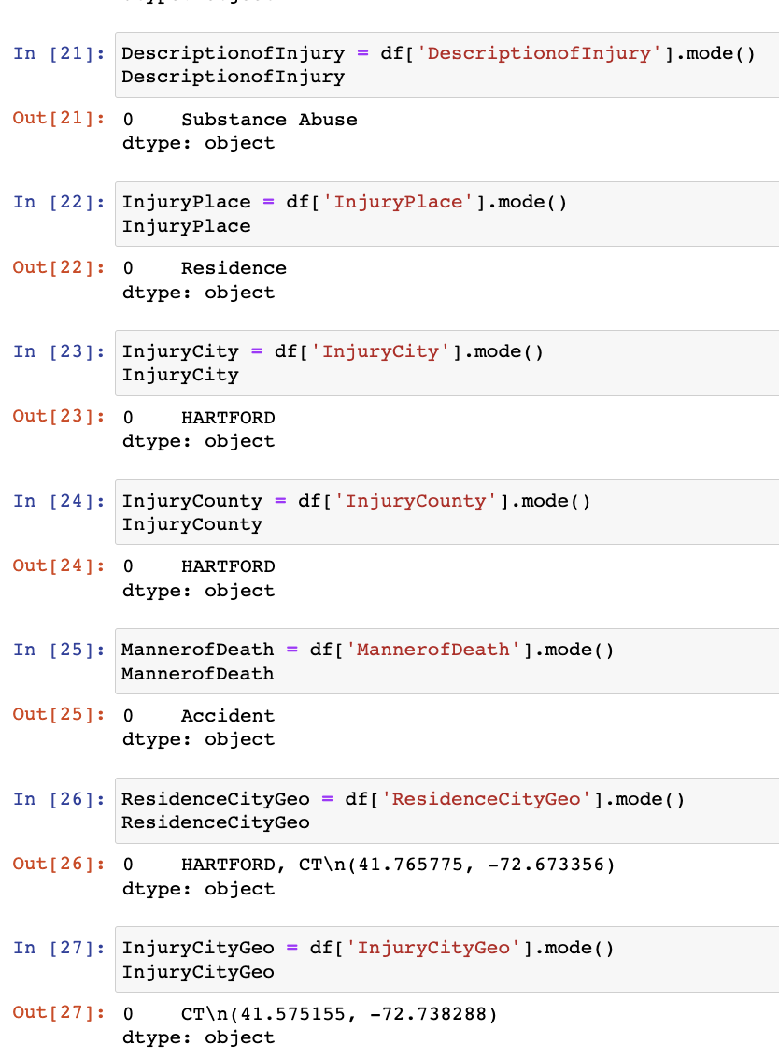

Slide 35
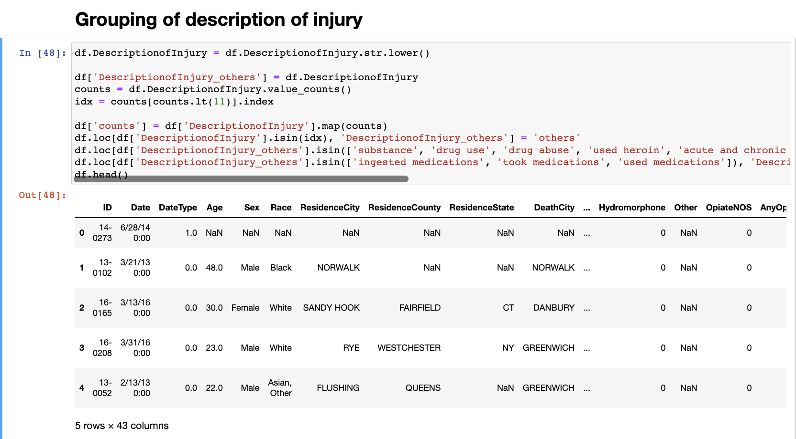

Slide 36
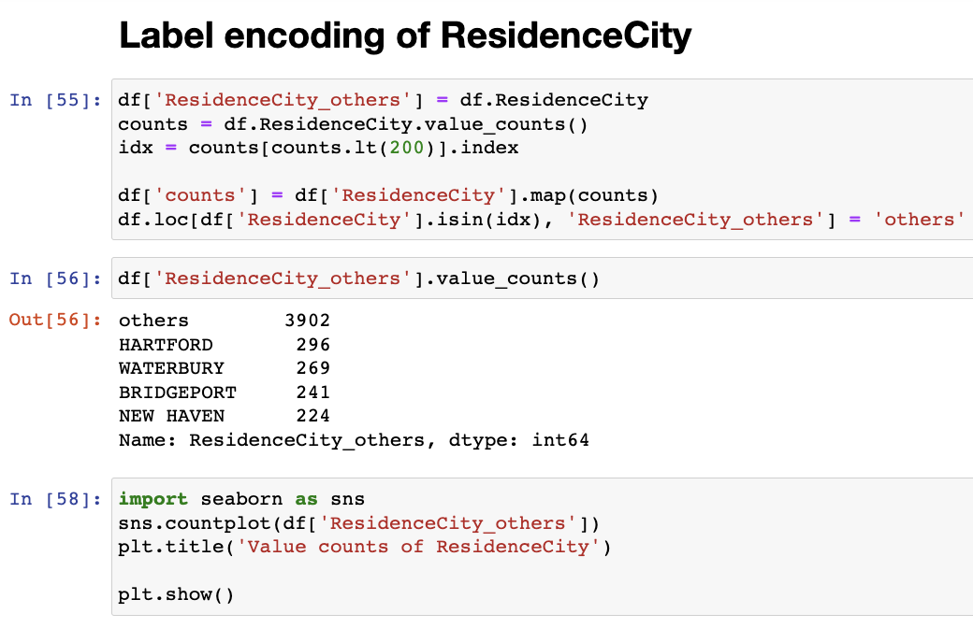
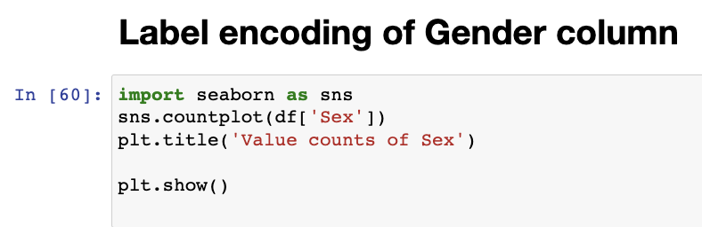
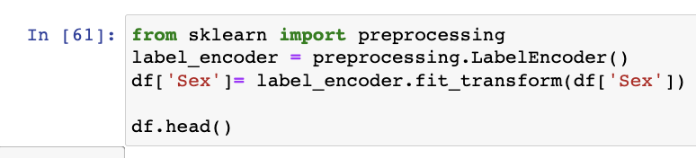
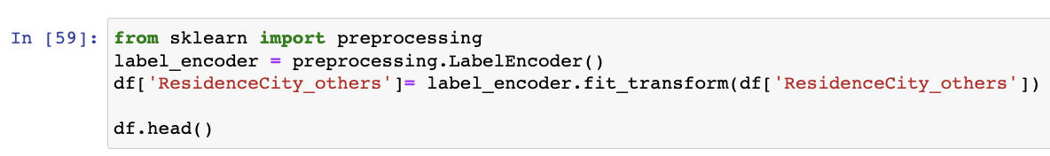

Slide 37
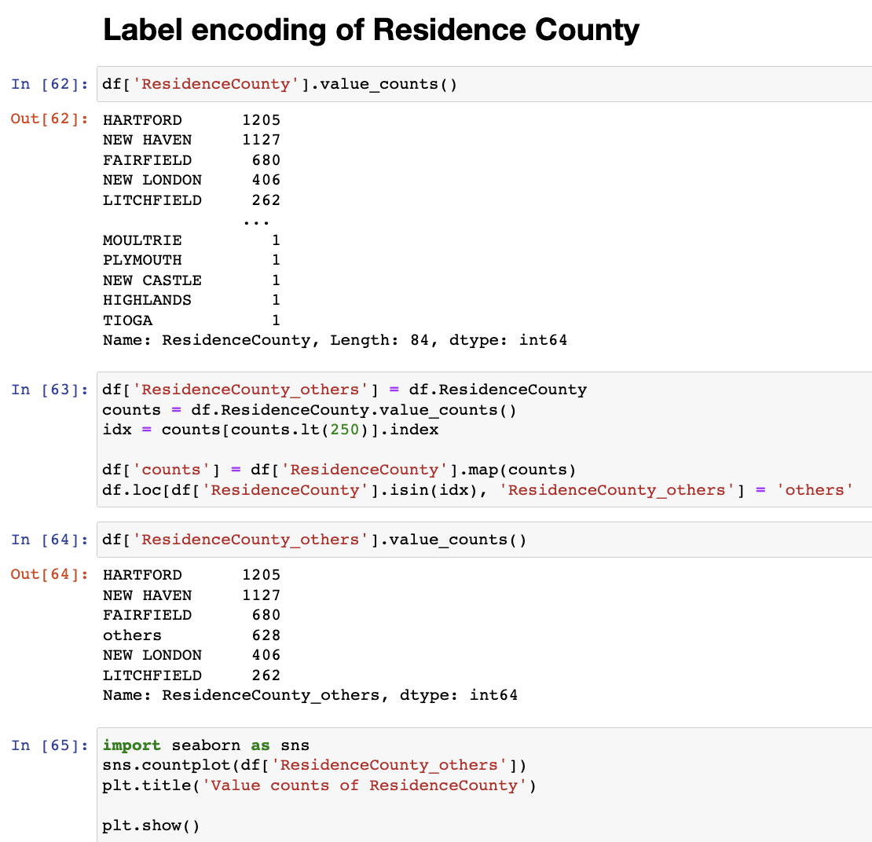
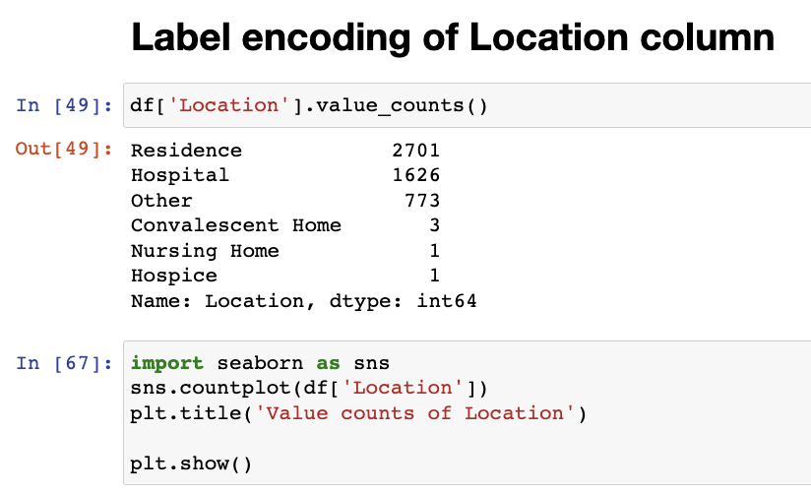
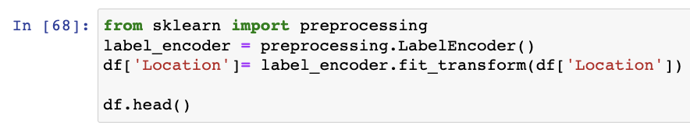
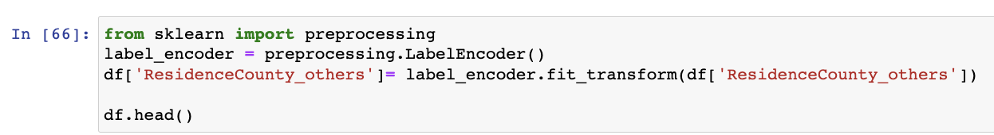

Slide 38
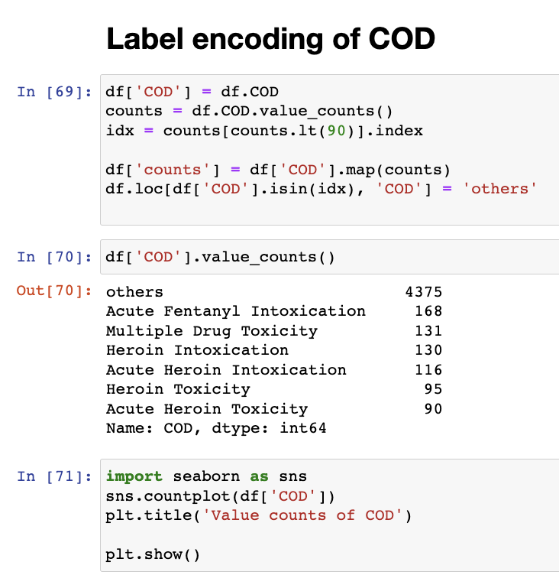
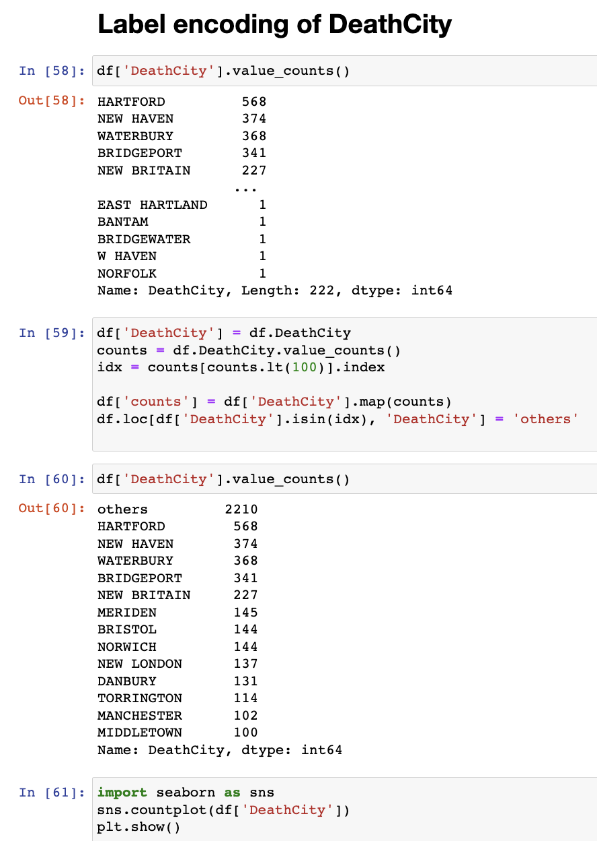
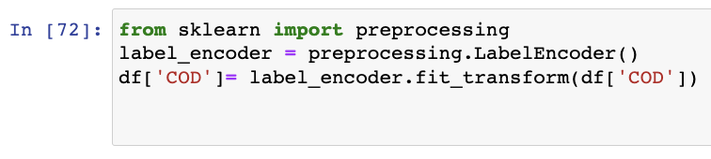
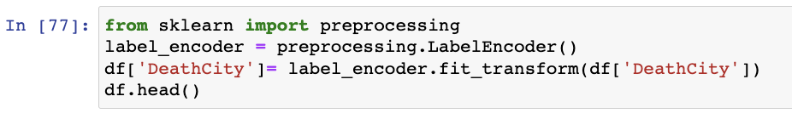

Slide 39
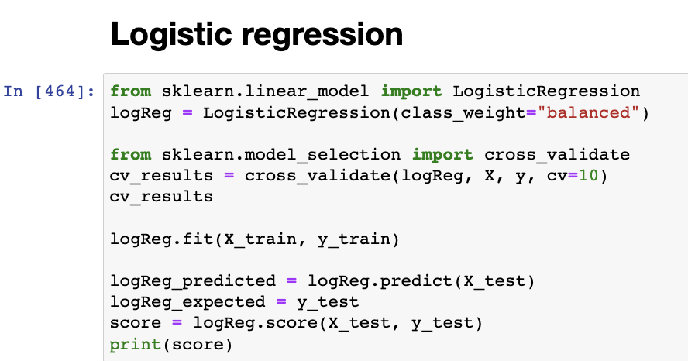
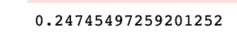
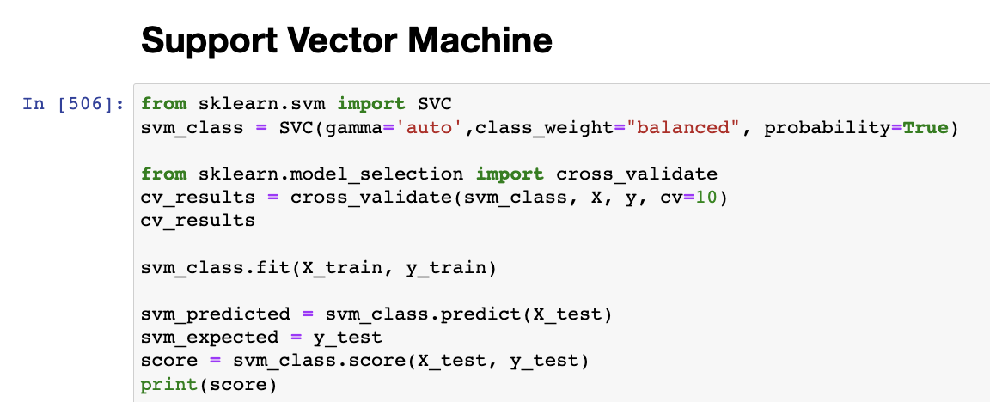
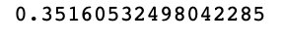

Slide 40
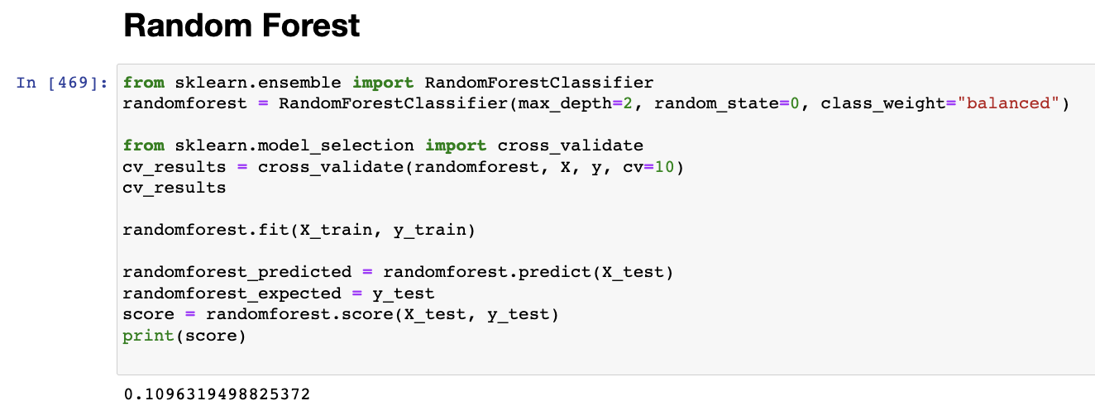
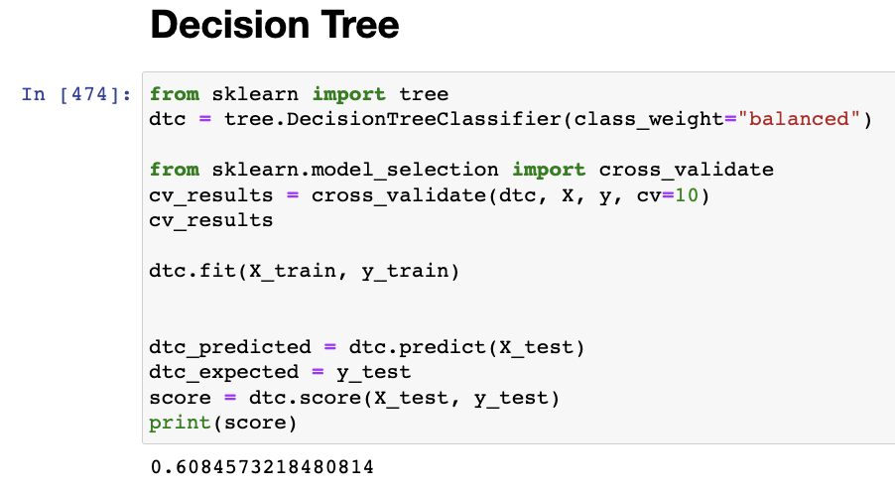

Slide 41
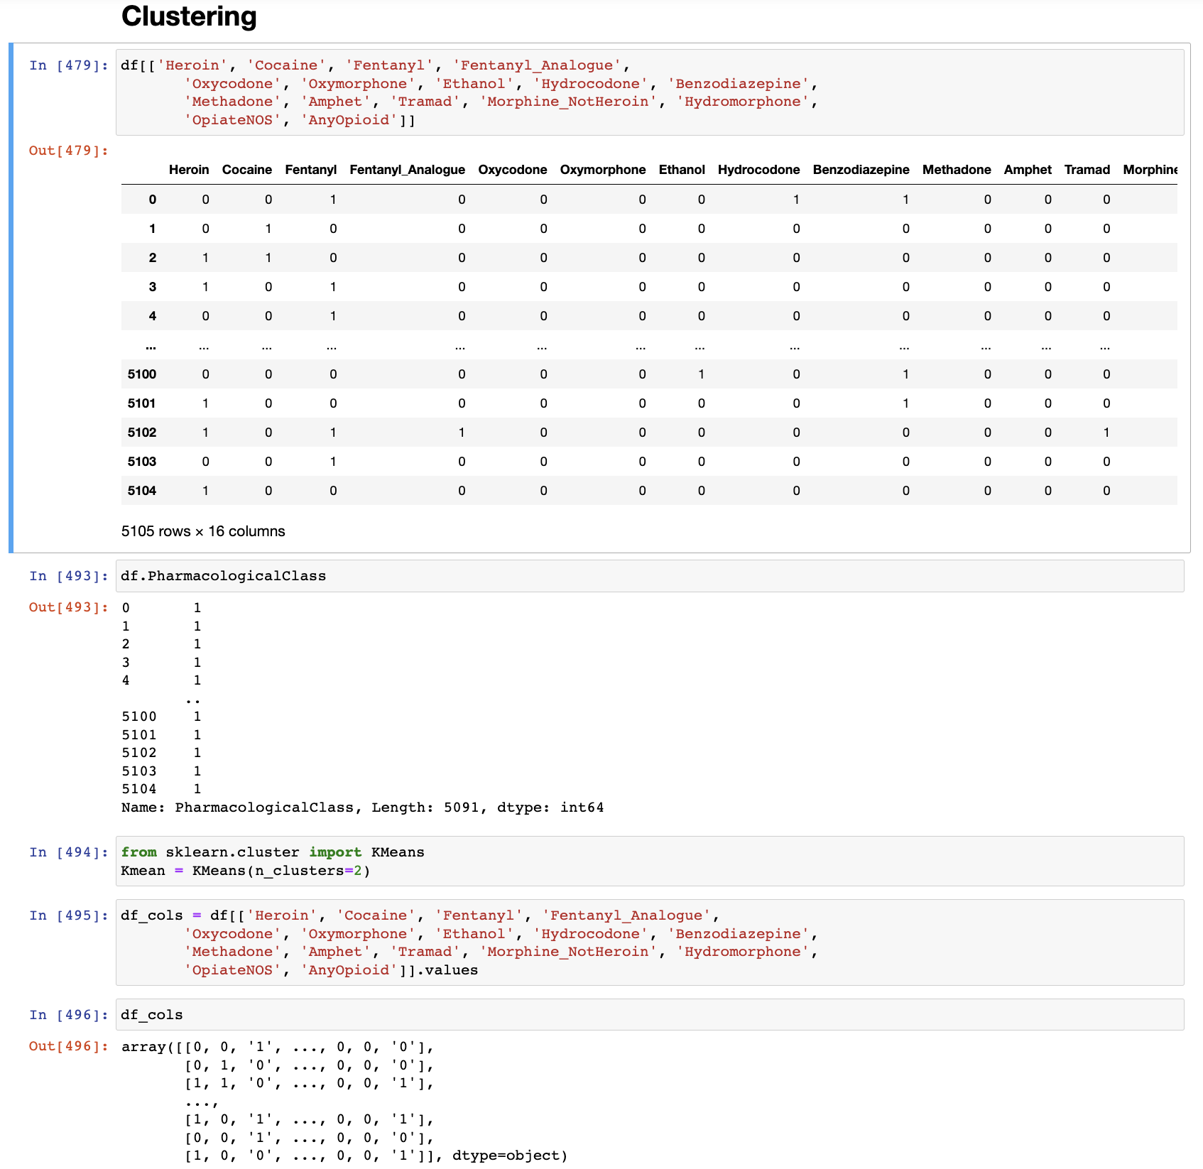

Slide 42
THANK YOU

